Slide 1


DR . SIVANTHI ADITANAR COLLEGE OF ENGINEERING
ARDUINO-BASED ADVANCED VEHICLE ACCIDENT DETECTION AND ALERT SYSTEM
PROJECT GUIDE MRS.E.KARPAGAVALLI ASP/EEE
Presented by A.CROSSWIN
UG - IV Year, Department of EEE,

Slide 2
ABSTRACT
"Arduino-Based Advanced Vehicle Accident Detection System" enhances road safety by quickly detecting accidents. It includes a power supply, Arduino microcontroller, GPS, GSM module, ADXL335 sensor, driver module, alarm, and LCD. Arduino controls the system, GPS tracks the vehicle, GSM alerts emergency services, ADXL335 senses acceleration changes, the driver module enables rapid response, an alarm warns nearby individuals, and the LCD displays real-time data. This system improves road safety by promptly detecting accidents and notifying authorities.

Slide 3
OBJECTIVE
The main objective of this project is to decrease fatalities resulting from vehicle accidents by promptly identifying accident locations and alerting emergency services through the utilization of GPS and GSM networks.

Slide 4
INTRODUCTION
Nowadays, road accidents pose a significant concern globally due to their devastating impact on lives and property. This project aims to leverage technological advancements to swiftly detect accidents and alert authorities, thereby mitigating their impact.

Slide 5
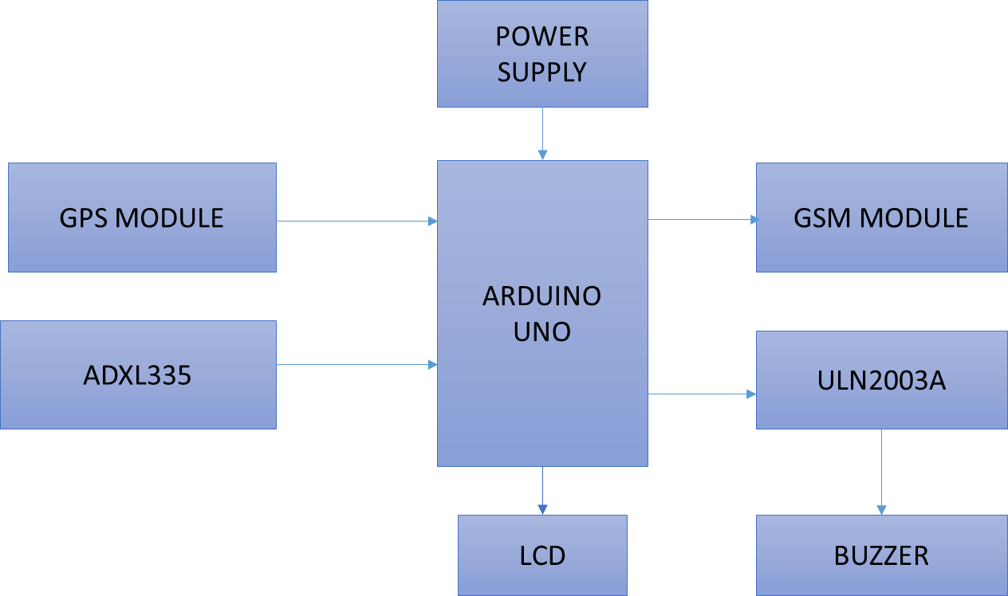
BLOCK DIAGRAM

Slide 6
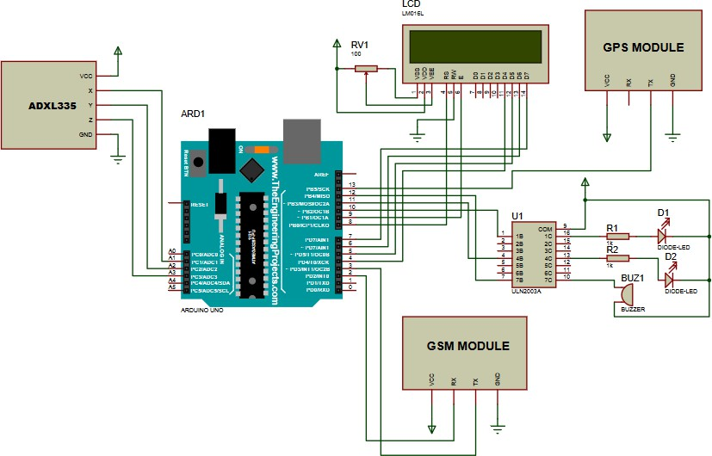
CIRCUIT DIAGRAM

Slide 7
COMPONENTS USED
ARDUINO UNO
GSM MODULE
GPS MODULE
ADXL335
ULN2003A
LCD DISPLAY
BUZZER

Slide 8
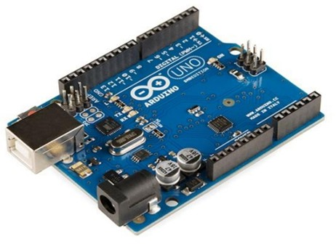
ARDUINO UNO
Arduino Uno is a versatile microcontroller board that serves as the foundation for countless electronic projects due to its ease of use and extensive community support. At its core, the Arduino Uno is built around the Atmega328P microcontroller, offering 14 digital input/output pins, 6 analog inputs, a USB connection for programming and power, a 16 MHz quartz crystal, a power jack, an ICSP header, and a reset button. This compact yet powerful board is widely utilized by hobbyists, students, and professionals alike for prototyping, experimenting, and creating interactive electronic devices.

Slide 9
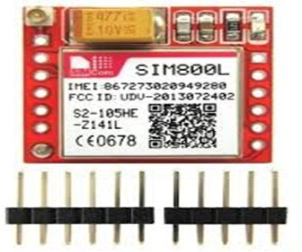
GSM MODULE
The GSM (Global System for Mobile Communications) module plays a pivotal role in the functionality of the home automation system, serving as a crucial communication link between the user's smartphone or tablet and the various home appliances and devices. This module enables remote control and monitoring capabilities by leveraging the ubiquitous cellular network infrastructure. By integrating the GSM module into the system, homeowners can interact with their smart home from anywhere with cellular coverage, granting them unprecedented convenience and flexibility. The GSM module facilitates two-way communication, allowing users to send commands to their home devices and receive real-time status updates and notifications.

Slide 10
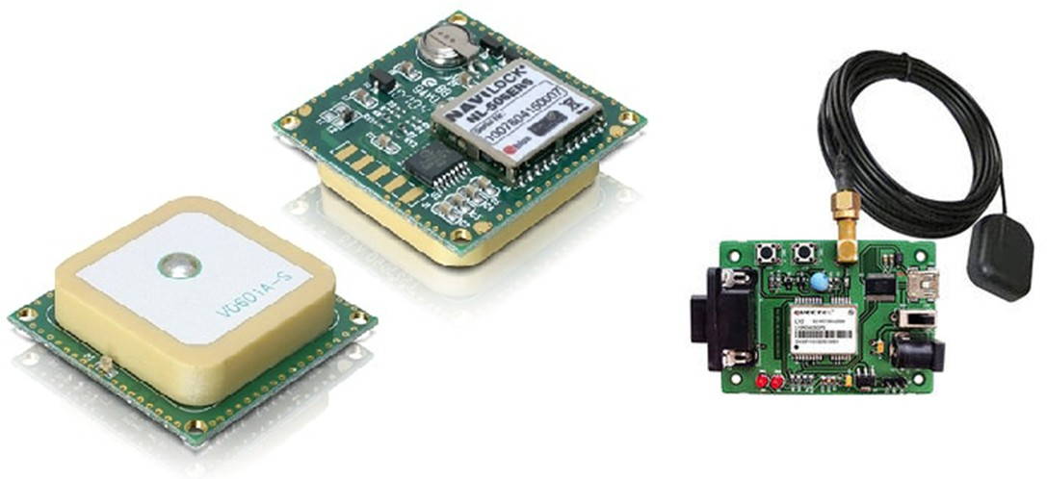
GPS MODULE
The Global Positioning System (GPS) is a space-based navigation system that provides location and time information in all weather conditions, anywhere on or near the Earth where there is an unobstructed line of sight to four or more GPS satellites. GPS receivers receive data from the satellite and also calculate their position by calculating its distance from then visible satellites and then by using triangulation method to calculate its position. The data given by the GPS receiver includes many information like position (latitude and longitude), altitude, speed, time etc.

Slide 11
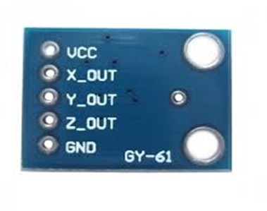
ADXL335
The ADXL335 is a small, thin, low power, complete 3-axis accelerometer with signal conditioned voltage outputs. The product measures acceleration with a minimum full-scale range of ±3 g. It can measure the static acceleration of gravity in tilt-sensing applications, as well as dynamic acceleration resulting from motion, shock, or vibration. The user selects the bandwidth of the accelerometer using the CX, CY, and CZ capacitors at the XOUT, YOUT, and ZOUT pins.

Slide 12
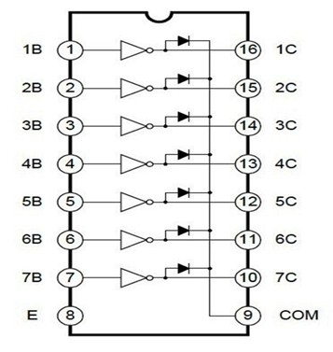
ULN2003A
ULN2003A is a high voltage and high current Darlington array IC. It contains seven open collector darlington pairs with common emitters. A darlington pair is an arrangement of two bipolar transistors. ULN2003A is for 5V TTL, CMOS logic devices. These ICs are used when driving a wide range of loads and are used as relay drivers, display drivers, line drivers etc. ULN2003A is also commonly used while driving Stepper Motors. Each channel or darlington pair in ULN2003A is rated at 500mA and can withstand peak current of 600mA.

Slide 13
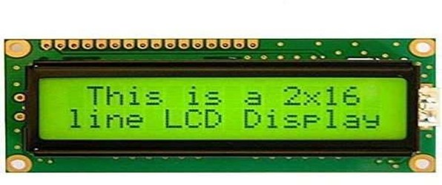
LCD DISPLAY
LCD (Liquid Crystal Display) screen is an electronic display module and find a wide range of applications. A 16x2 LCD display is very basic module and is very commonly used in various devices and circuits. A 16x2 LCD means it can display 16 characters per line and there are 2 such lines. In this LCD each character is displayed in 5x7 pixel matrix. This LCD has two registers, namely, Command and Data. The command register stores the command instructions given to the LCD. A command is an instruction given to LCD to do a predefined task like initializing it, clearing its screen, setting the cursor position, controlling display etc.

Slide 14
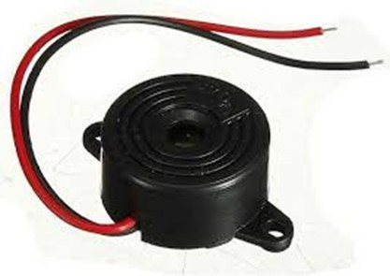
BUZZER
A buzzer is an electronic device designed to produce a buzzing or beeping sound when activated. It typically consists of a housing, a vibrating element (such as a piezoelectric crystal or an electromagnetic coil), and a mechanism for producing the desired sound. When an electrical current is applied to the buzzer, the vibrating element oscillates at a specific frequency, generating sound waves that result in the characteristic buzzing or beeping noise.

Slide 15
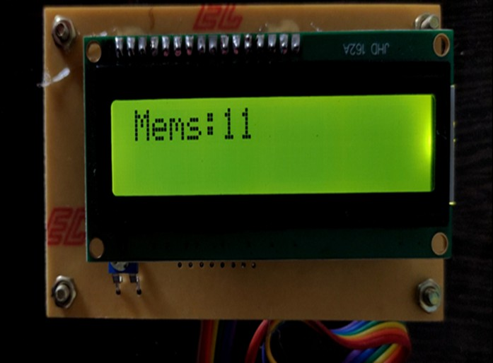
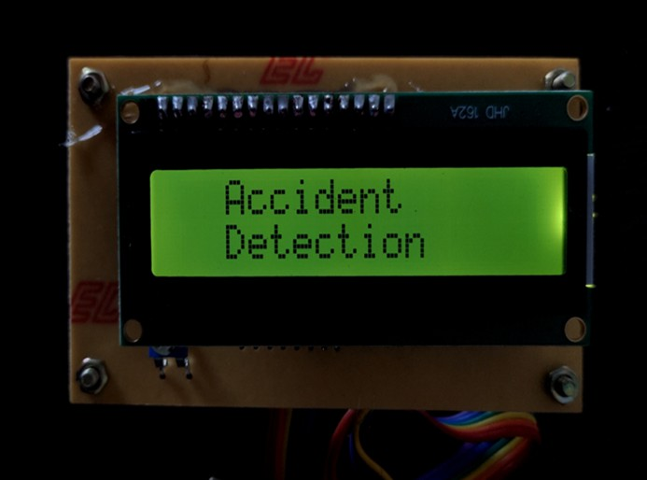
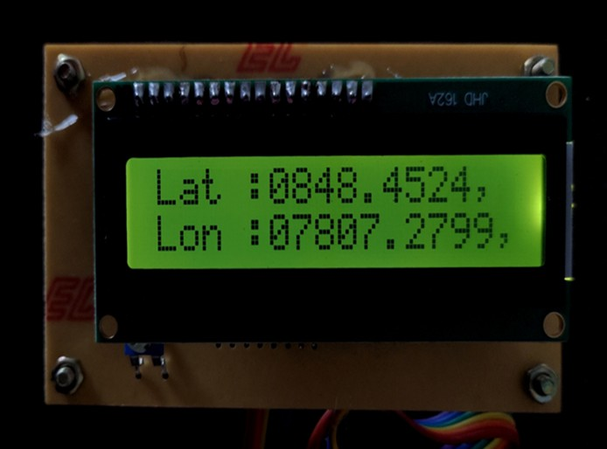
LCD OUTPUTS

Slide 16
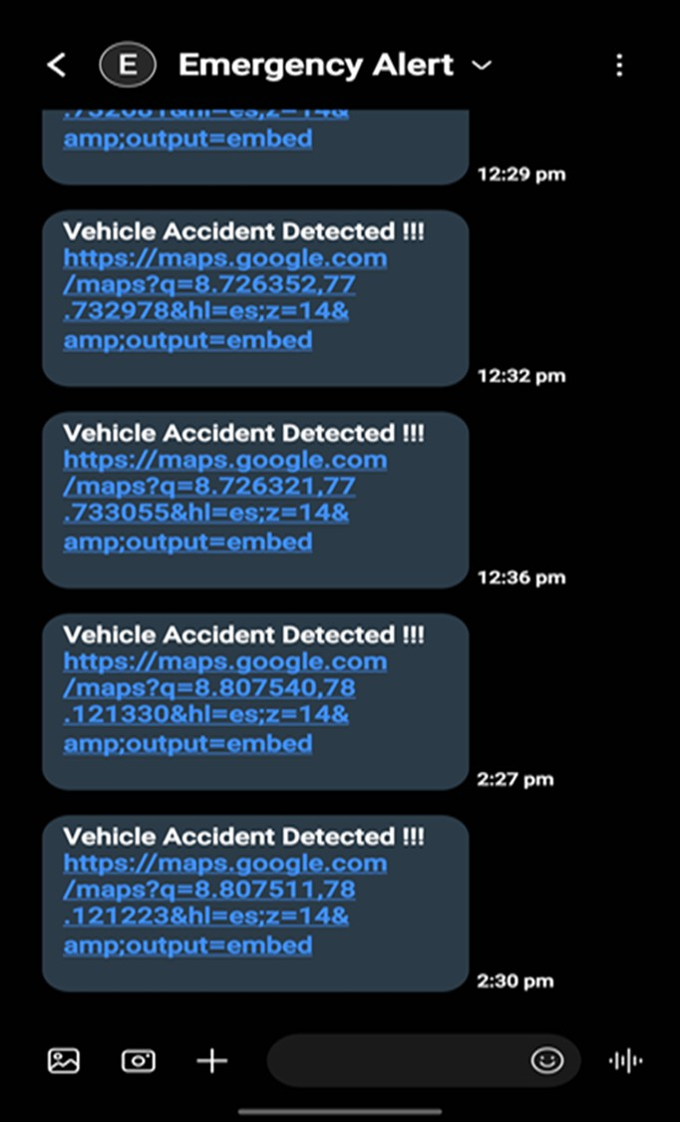
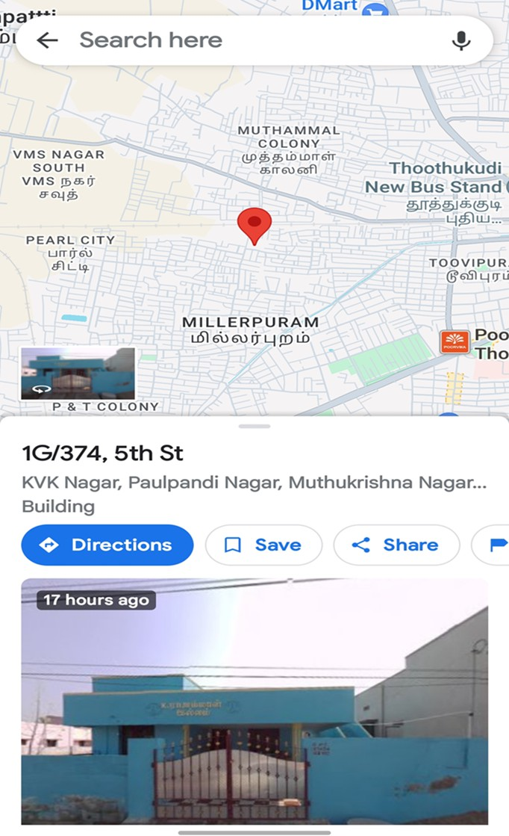
SMS ALERT AND LOCATION DETAILS

Slide 17
ADVANTAGES
6 Tracking technology enables swift identification of vehicles involved in accidents without delay.
6 Accident victims in remote areas receive immediate medical attention.

Slide 18
DISADVANTAGES
6 Communication difficulties arise in areas lacking GSM and GPS network coverage, hindering effective response.

Slide 19
CONCLUSION
In conclusion, the integration of GPS and GSM technologies into emergency response systems offers a promising solution to mitigate the severity of accidents and reduce fatalities. These technologies enable swift and precise location tracking, facilitating prompt action by ambulance and police services. By leveraging these tools effectively, we can enhance overall road safety and minimize the impact of accidents on individuals and communities.

Slide 20


